Slide 1

RULES FOR THE
2020 SOLAR CAR CHALLENGE

Slide 2
EVENT UPDATES
The Rules are periodically clarified or amended to meet the needs of the specific race.
Rule 29 requires solar car teams to make periodic reviews of these updates to stay up-to-date.

Slide 3
Rules Overview
Do:
  Keep copies of rules throughout workshop
  Following engineering lifecycle: requirements, design, implementation, verification
Don’t:
  Just read once or all in one sitting
  Look at another car’s design and assume it complies with rules (grandfather; waivers)

Slide 4
Important Dates
September 1 to January 31 - “Intent-to-Race” Form
This notifies Race Officials that you plan to participate in the 2019 Solar Car Challenge, and places your team on a mailing list to receive Event Updates and other mailings. This form must be
filed to file a registration document.
March 1st - File Registration Document
This includes full documentation about your solar car project as required by Rule 3.6, and your team’s
registration fee.

Slide 5
Registration
Sections 1 – 3: Purpose, Administration, Entries and Registrations
Registration Documents and Registration Fee requirement March 1st:
(1) Detailed CAD drawings showing mechanical structure, including “crush zones.” Crush zones must be clearly labeled.
(2) Detailed schematic / wiring diagram showing electrical system.
(3) Digital team photo [emailed]
(4) Manufacturer’s data sheets for batteries showing type & capacity
(5) Manufacturer’s data sheets for solar array, including list price
(6) Manufacturer’s data sheets for motor and motor controller
(7) Manufacturer’s data sheets for array and battery cutoff switches
(8) Manufacturer’s data sheets for main fuses
(9) Manufacturer’s data sheets for wheels and brakes
Digital and hard copies required by March 1st.
[Rule 3.6]

Slide 6
Rule 3.8 – Design of Solar Car
It is the intent of the event that the solar cars be designed and constructed by high school students on the solar car team.
No portion of another vehicle’s frame may be reused in a solar car unless the team re-engineers/modifies the frame to fit the team’s solar car design or to install separate off-the-shelf components.

Slide 7
Rule 3.9 - Scrapbook
Scrapbook must be shown to Check-In to Race.
Scrapbook must show history of the team building the solar car, including team engineering decision-making.
Scrapbook will show team photos, design & planning, CAD drawings, fundraising, testing.
Digital copy of scrapbook due June 1st.

Slide 8
Rule 3.10 – Oral Presentations
Up to 20 laps not available for oral presentations.
Presentation show discuss the teams overall planning, including engineering decisions.
Teams have a strict 8 minutes to give their presentation.
Judges will now give feedback per Oral Presentation Guidelines

Slide 9
Qualifier
Qualifier for the 2020 Race will include:
  3-Day Scrutineering
  Stage One – First Day of Racing
  The top teams in each Solar Car Challenge Racing
  Division will move on to the three-day Stage Two
  of racing. [Approximately 25 teams]
  The winner in each division will be the team that accumulates the most laps in Stare 1 and 2.
  All teams will receive an Official Race Ranking

Slide 10
Section 10: DIVISIONS
Classic Division: No hub motors; lead-acid batteries; solar modules at ≤ 20% efficient
Advanced Classic Division: 3 or more years in classic with same basic vehicle structure and major components
Advanced Division: Hub motors; prefabricated solar car molds; advanced battery chemistries
Electric-Solar Powered Car Division: Solar cells on charging station; Classic Division technology; 2 x 2kWh battery packs
Cruiser Division: Seating for four; totally enclosed; solar array integrated into the skin of the vehicle; workable trunk

Slide 11
Section 5: SOLAR CAR REGULATIONS
5.1 – Dimensions – Length = 5m, Height = 1.6m, Width = 1.8m
5.1.2 – Stability [Tilt Test]
5.1.3 – Body of Vehicle – windshields required, but body is not required unless judges determine that driving without a body would be unsafe. A belly pan is required.
Crush Zones drawings must include vertical and horizontal dimensions and dimensions of Roll Bar. [Rule 3.6]
5.2 – Structure – teams must be able to demonstrate specific, adequate “crush zones.”
5.2.1 – Roll Cage welded to frame (1.9cm OD, 5cm clearance)
5.2.2 - Crush zones (15cm from driver in all directions)
5.2.3 – Roll Bar welded to frame 5cm above driver’s head (5cm OD) and must be construction of one continuous piece of metal.

Slide 12
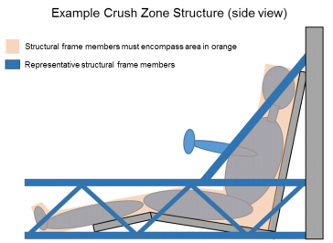

Slide 13
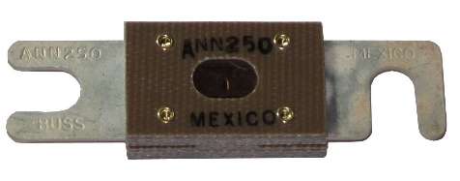
Section 5.4 - ELECTRICAL
[5.4] Batteries: 5 kWh max at 20 hr discharge rate; terminals must have locking washers.
[5.4.2] Main Fuse: 125% of expected peak current, separate enclosure; Rated as appropriate for DC voltage;
← Made by Copper Bussman (~$20)
ANN = Very Fast Acting
[5.4.3] Enclosures: Rigid, must have forced-air ventilation; no venting into driver’s compartment
[5.4.4] Supplemental Batteries: Powers all devices other than propulsion; must have low battery warning system
[5.4.5] Disconnect Switches: Must be push-off; 2 each of motor and array disconnects. Relay/contactor in 2021!

Slide 14
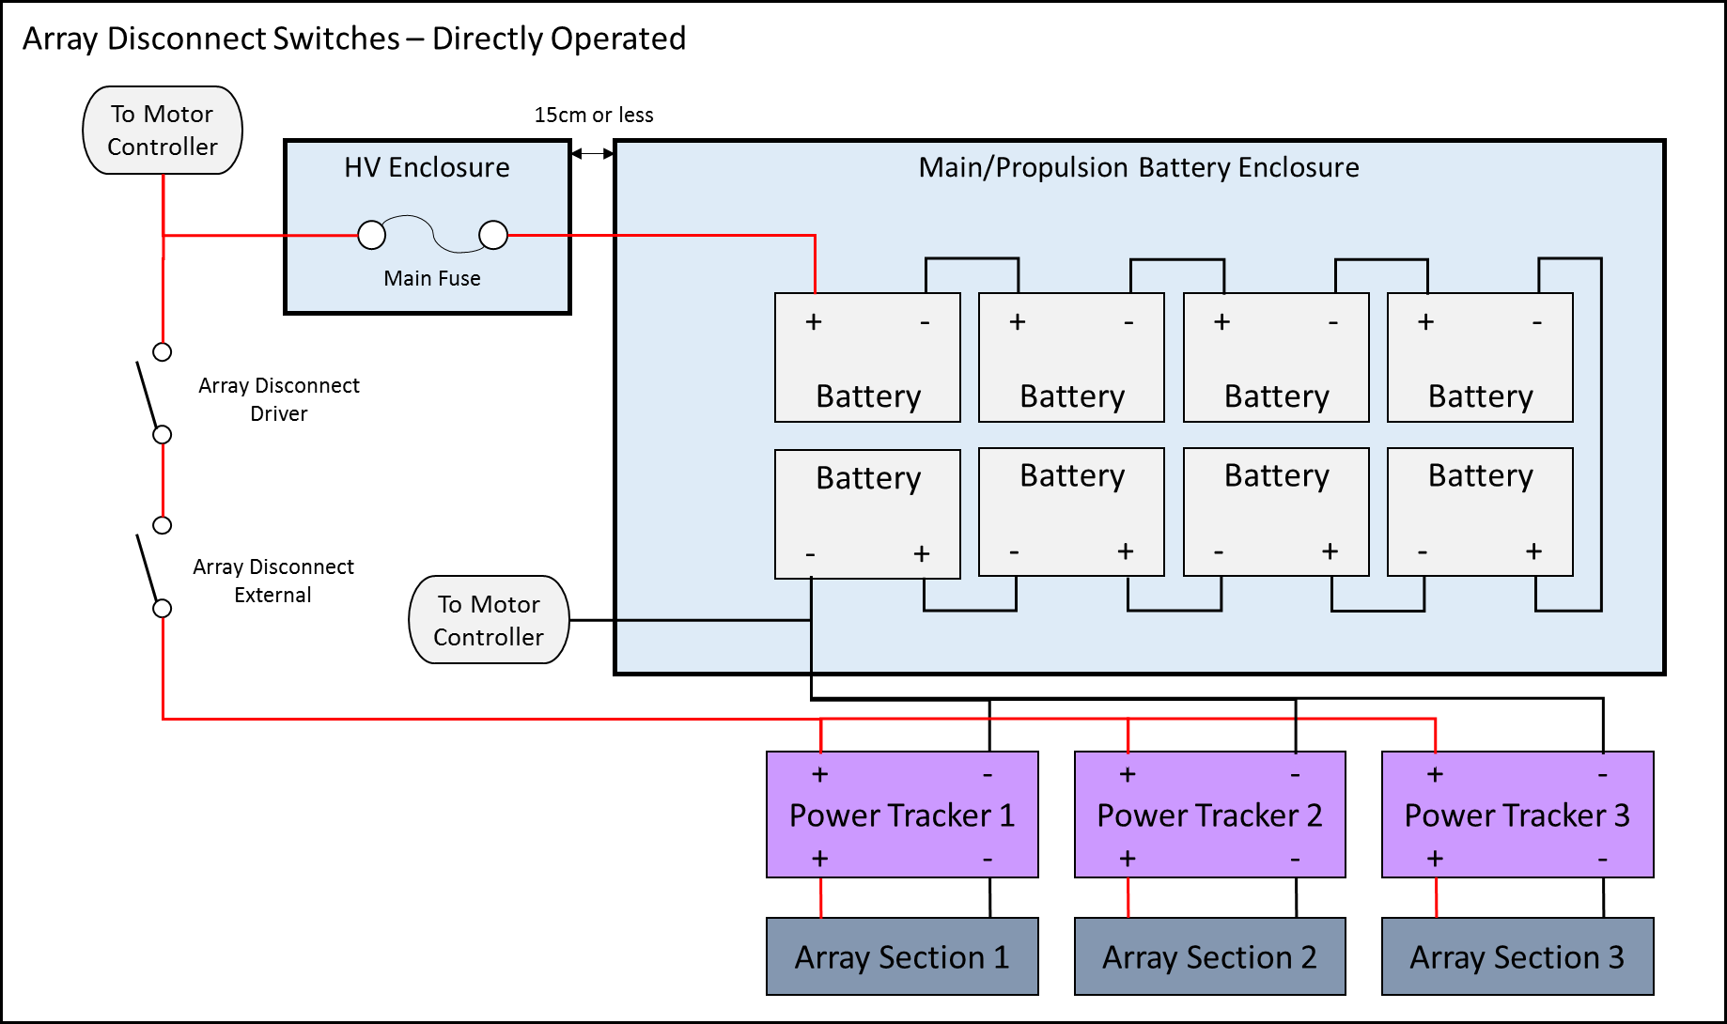

Slide 16
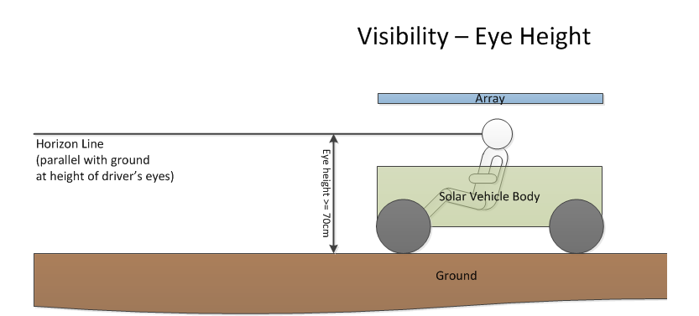
5.5 – Electrical System Grounding – no grounding to frame
5.7 – Wire, Insulation, Connections – properly sized wire
(use wire table; sized to continuous system current)
*For 2021, no HV wire in driver’s compartment*
5.9 – Visibility

Slide 17
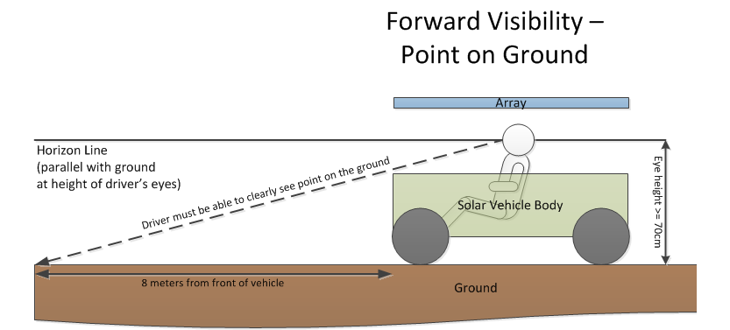

Slide 18
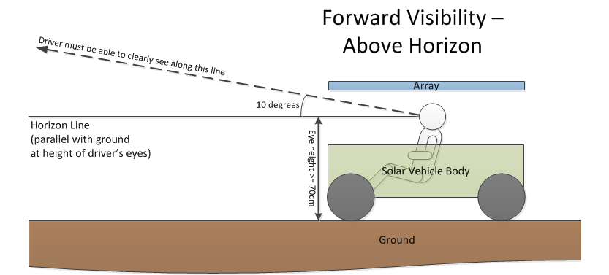

Slide 19
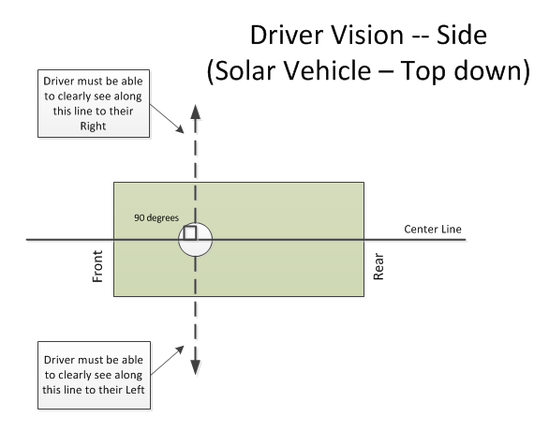
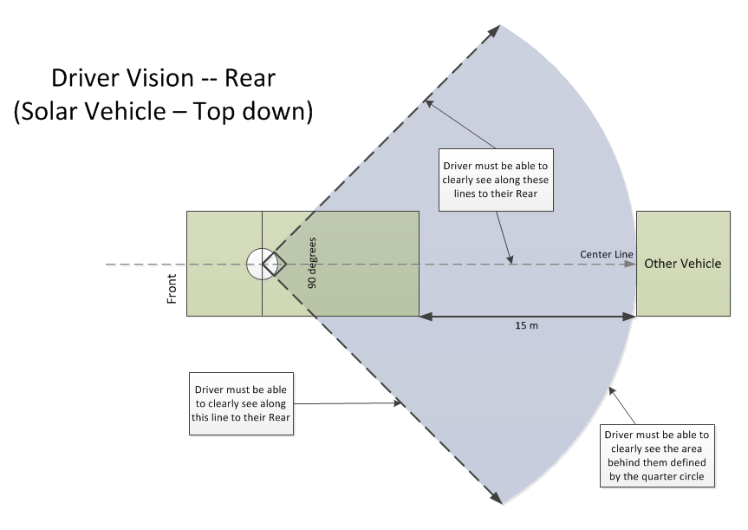

Slide 20
5.10 – Braking test at Low Speed and High Speed
5.11 – Steering and turning radius [15-meters]
5.12 – Warning Systems – Turn Signals, Hazards, and Horn
Stop – red lights; Turn & Hazards – amber lights
5.13 – Driver Safety
(a) Safety Belt – 5 point lap & shoulder belt [Grade 8 bolts] attached to frame of solar car
(b-c) Impact Protection (body shells attached)
(d) Windshield must protect driver’s entire face
(e) Cockpit egress in 15 seconds
(f) Fire extinguishers [Appropriate to battery type]
(g) Liquid container properly secured to the vehicle
(h) Belly pan
(i) Forced Air Circulation
(j) Driver seat provides neck support & is bolted to frame
(k) Battery spill kit (baking soda)
(l) Closed toe shoes/hats
(m) Protective Eyewear in garage area

Slide 21
5.14 – Throttle
5.15 – Covers & Shields
5.16 – Electrical shock hazards – HV signs; properly insulated
5.17 - Radios
6 – Nature of the Event – Closed Track Race
Teams accumulate laps driving around Texas Motor Speedway. Partial laps do not count. The team achieving the most laps over the four days of racing will be declared the winner.
6.1 – Elapsed time
6.2 – Taking part in special events and Challenge Event
6.3 – Items provided by Race
6.4 – Items provided by participants
6.5 – “Trailering” provisions
6.8 – Charging
6.9 – Impound
6.11 – Attire – full brim hats, closed-toe shoes, jeans/shorts
7 – Scrutineering
7.8 – Required use of welding screen
8 – Registration
8.3 – Registration Fee
8.5 – Team guests must comply with race rules

Slide 22
Sections 9, 11-21: How the race is run; read to understand what a day is like
19. Support vehicles – teams must have a support vehicle with trailer so that they can go out onto the track to pick up the solar car in the event of a break down.
23. Judging – responsibilities of judges; duty to judges
24. Penalties
25. Protests
29. Responsibility to CHECK UPDATES

Slide 23
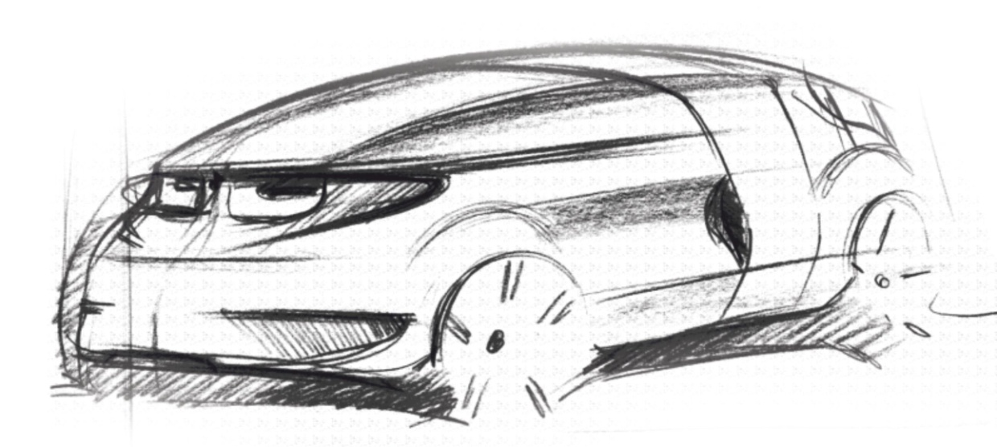
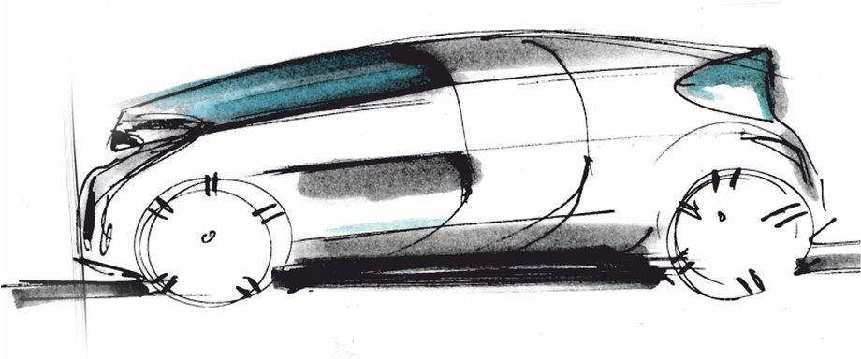
32 – Electric-Solar Powered Car Divisiom

Slide 24
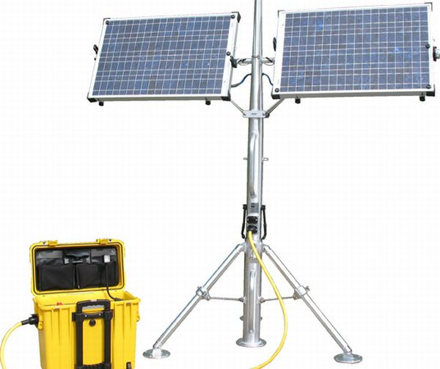
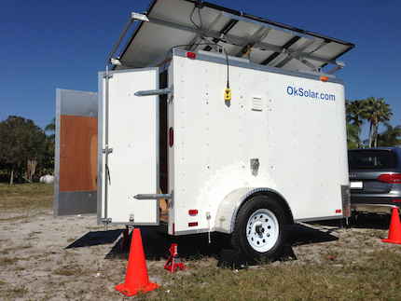
32.1 Concept – The Electric-Solar Power Car Division is designed to simulate a “real world” solar application.
(a) Two passenger vehicle
(b) Solar Power Charging Station simulates a permanent facility that would be used to charge the vehicle

Slide 25
32.2 Physical Regulations
32.2.1 The Electric-Solar Power Car is governed by all the regulations set out for a Classic Division Solar Car, except where exceptions are provided in this Addendum.
32.2.2 Dimensions – the Electric-Solar Power Car will have the following minimum dimensions: Length – 4.5 meters; Height – 1.5 meters; Width – 1.5 meters. (no maximum dimensions)
32.2.3 Configuration – the Electric-Solar Powered Car must accommodate two passengers.
32.1.3 (a) - The passengers must be seated in a comfortable upright position to simulate a “real world” environment.
32.1.3 (b) - One passenger will be designated the “driver”; the other passenger will be designated the “technician” for communications, data collection, and strategy coordination.

Slide 26
32.2.4 Driver Weight – the minimum weight of the two drivers must be a total of at least 320 pounds. If the sum of the drivers’ weight is less than 320 pounds, the solar car must carry a ballast.
32.2.5 Power – powered by interchangeable battery boxes charged by the sun at the team’s Solar Power Charging Station.
32.2.6 Battery - teams can have two battery boxes: one battery box will be in the solar car; the other battery box will be charging at the Solar Power Charging Station. Battery packs have 2 kWh max each.
32.2.7 – Disconnects - The Electric Solar Powered Car must have two Motor Disconnects per Rule 5.4.5. A single Array Disconnect must be located on the Solar Power Charging Station that is readily accessible to by-standers. No Array Disconnects are required for the Electric Solar Powered Car.

Slide 27
32.3 Solar Power Charging Station
32.3.1 Array – the solar power charging station can have an array no larger than 5 meters by 1.8 meters. Solar Cells must be 19% efficiency or less.
32.3.2 Location – charging station in designated area, permanent once set up; can be rotated
32.3.3 Stability/Durability – the solar power charging station must be a stable facility capable of withstanding reasonable weather conditions. This includes gusts of wind up to 40 mph and rain.
32.4 Battery Box Exchange Procedures
32.4.1 Batteries exchanged in designated area; monitored by judge
32.4.2 Once installed, solar car moves back onto race course.
32.4.3 Every car will drive a defined track
32.7 Team Assignments – Perform special “real-world” task each day

Slide 28
  Rule 33 – Cruiser Division
  Concept – The Cruiser Division is designed to resemble a regular passenger vehicle and provides teams an opportunity to include strategy by determining the number of passengers to carry throughout the challenge. Teams receive points equivalent to the number of passengers carried multiplied by the distance traveled.
  33.2.1 – Governed by Advanced Division Guidelines
  33.2.2 – Four Wheels
  33.3.3 – Seats four people with four doors
  33.3.4 – Passenger weight (160 lbs or ballast)
  33.3.5 – Enclosed Body
  33.3.6 – Integrated Array
  33.3.7 – Trunk
  Points for Driving is based on the number of laps x number of people in the vehicle.

Slide 29
  ATTIRE - Attire for all participants (including students, sponsors, chaperones, advisors, and others participating or traveling with team) in the Solar Car Challenge must be appropriate.
  All participants must wear full-brimmed hats when in direct sunlight and closed-toe shoes throughout the event. Jeans are recommended for protection when working on the car and when kneeling on the ground. Shorts must be longer than the longest fingertip.

Slide 30
Attire during the Solar Car Challenge
The Solar Car Challenge is based on the philosophy of “cooperation rather than competition.” Our event focuses on bringing teams together through the camaraderie of the solar car experience.

Slide 31
In keeping with this philosophy, we ask that team attire, banners, and printed materials focus on their solar car team logo, “school pride,” or community.
No attire, banners, or printed materials will be allowed that seek to promote any political candidate or philosophy. Failure to follow this guideline will result in the removal of the offending items and/or disqualification from the event.

Slide 32
Use of Solar Car Challenge Logo
The Solar Car Challenge logo is the federally registered trademark of the Solar Car Challenge Foundation. It cannot be used by teams for items of attire, banners, or printed materials without the prior written approval of the Solar Car Challenge President.

